Slide 1
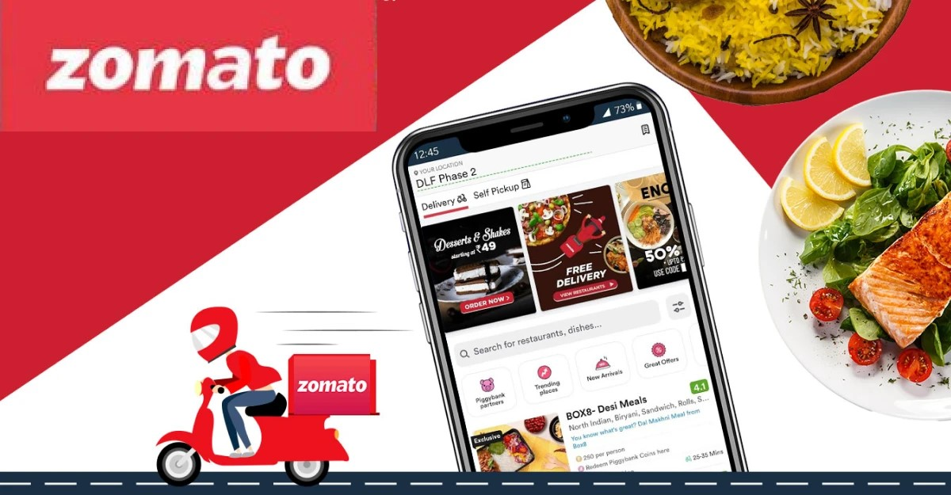
Zomato – Worldwide Restaurant Network Analysis

Slide 2

Company Name : zomato
Company Type : Food Delivery Company
Founder : Deepinder Goyal and Pankaj Chaddah
Year Founded : 2008
Headquater : Gurugram, India
Employee Size : 3800
Business Valuation : $ 8.59B (as of Aug 2023)

Slide 3
Objectives
Conduct a detailed exploration of Zomato's global restaurant dataset to gain a deep understanding of its variables, structure, and unique characteristics.
Cleanse and prepare the dataset, addressing missing values, outliers, and inconsistencies to ensure data accuracy and maintain consistency.
Analyze the geographic distribution of Zomato restaurants across cities and countries, providing insights into the global reach and presence of the platform.
Explore temporal trends in restaurant openings, examining yearly, quarterly, and monthly patterns to identify correlations and uncover insights related to temporal aspects.
Investigate the distribution of restaurants based on their average ratings, exploring patterns and trends that may reveal correlations with other influencing factors.

Slide 4
Project Stages
Dataset Understanding.
Key Performance Indicator(KPI) Implementation.
Excel Implementation.
Power BI Implementation.
Tableau Implementation.
Business Insights and Recommendations.

Slide 5
Data Understanding
Currency
Main
Country
Currency
CountryCode
Dataset | Records
Main Dataset | 9551
Currency Dataset | 13
Country Dataset | 16
Dataset Type | Excel File
Record Types
String
Timestamp
Currency
Boolean

Slide 6
Data Cleaning and Exploration
Data Importation
Imported Data into required analysis tools(e.g. Excel, Power BI, Tableau, MYSQL)
Intial Assessment
Reviewed the dataset to understand its structure and variables.
Handling Missing Data
Identified and addressed missing values, which involved either removing rows or filling them with appropriate values.
Data Transformation
Converted data types as needed, including changing strings to numbers where necessary.
Data Standardization
Ensured consistent data formats for variables, including standardizing dates, currencies, and units.

Slide 7
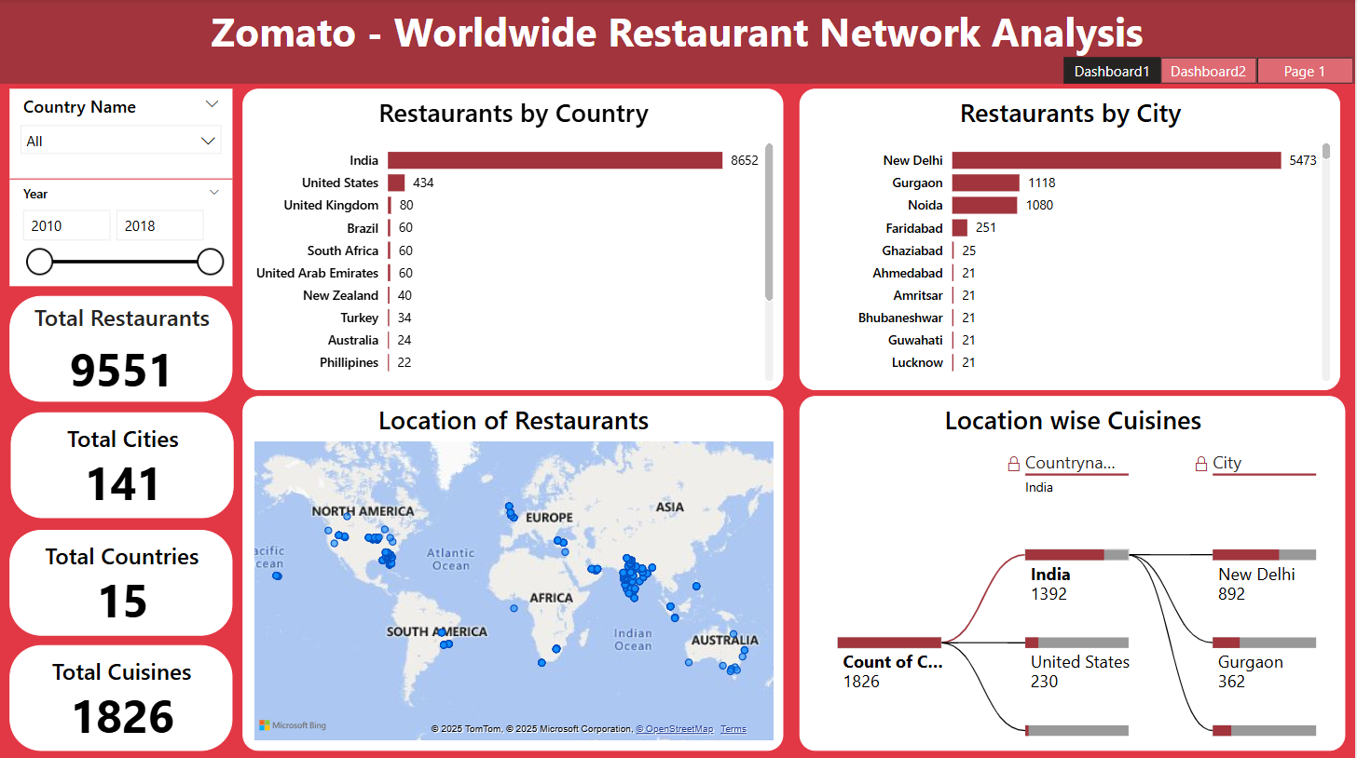
Power BI Implementation

Slide 8
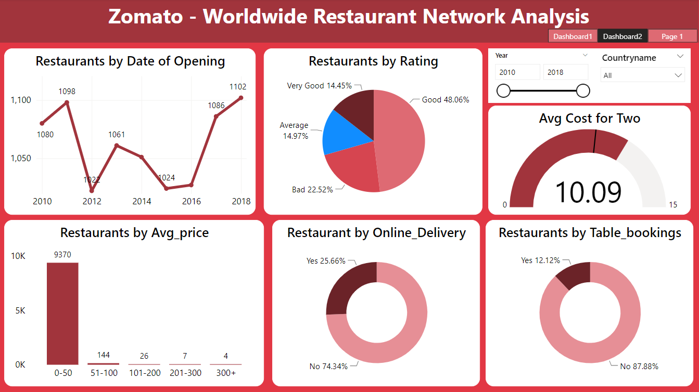
Power BI Implementation

Slide 9
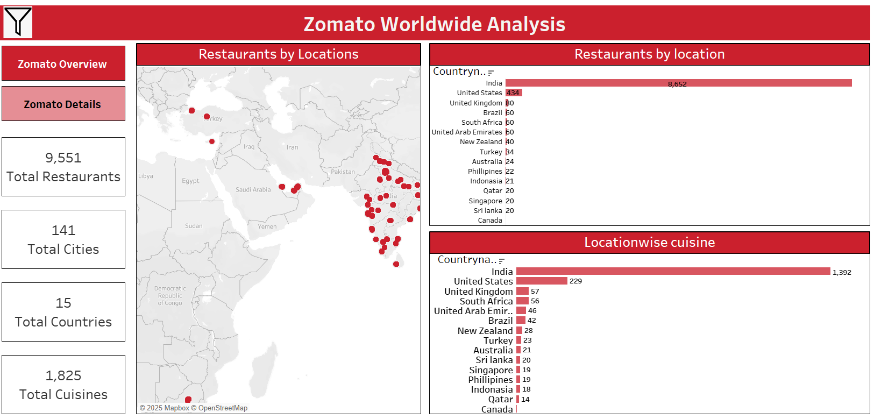
Tableau Implementation

Slide 10
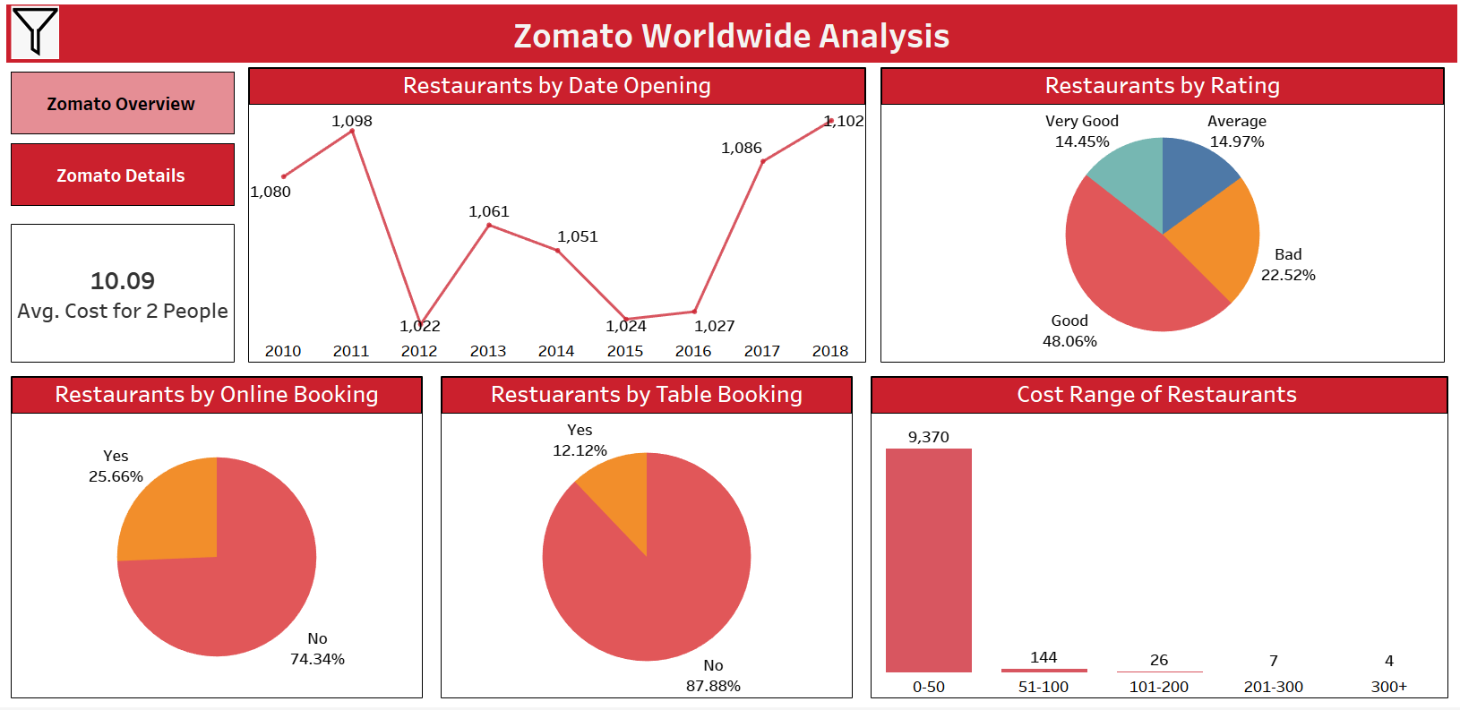
Tableau Implementation

Slide 11
KPI Results
Global Presence Overview:
Zomato has a widespread presence with 9,551 restaurants across 141 cities and 15 countries.
Culinary Diversity:
The platform offers a diverse culinary experience with a staggering 1,826 different cuisines provided by all its restaurants.
Country-wise Restaurant Distribution:
India leads with the highest number of restaurants at 8,652, followed by the US with 434 and the UK with 80. Other countries contribute to the global network.
City-wise Restaurant Landscape:
New Delhi stands out with the highest number of restaurants, hosting 5,473 establishments. Other cities also contribute to the extensive restaurant network.
Temporal Trends in Openings:
In 2018, there was a peak in restaurant openings with 1,102 establishments. In 2012, openings were at a minimum with 1,022. The dataset spans from 2010 to 2018.
Rating Distribution:
Almost 48% of restaurants receive a good rating (3 to 4 out of 5). Around 14.5% are rated very good, 15% average, and 22.5% are rated as bad.
Average Price Range:
The majority of restaurants (9,370) offer a range of food priced between 0 to 50 USD for two people.
Online Delivery and Table Booking Services:
Approximately 25% of restaurants provide online delivery, while 75% do not. For table booking, 12% offer the service, while 88% do not.

Slide 12
Recommendations
Leverage widespread presence for global marketing and brand visibility; explore expansion in countries with fewer restaurants.
Promote diverse culinary offerings as a unique selling point; highlight specific cuisines in marketing for wider appeal.
In India, invest in the market with the highest restaurant count; explore growth in countries with lower counts for new markets.
Focus on sustaining and improving restaurant landscapes, especially in high-demand cities like New Delhi.
Capitalize on temporal trends, especially the peak in 2018, for strategic planning; investigate factors contributing to 2012's minimum openings.
Develop strategies to improve ratings, particularly for restaurants falling into the "bad" category; implement customer feedback mechanisms.
Utilize the popularity of restaurants in the 0 to 50 USD range; consider periodic promotions for enhanced customer loyalty.
Enhance online delivery services for the 25% of restaurants; explore opportunities to introduce table booking services in high-demand areas.

Slide 13
Thank You

